Slide 1
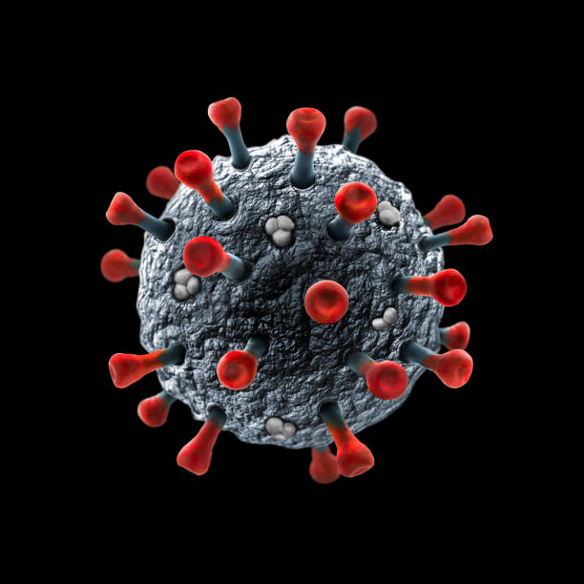
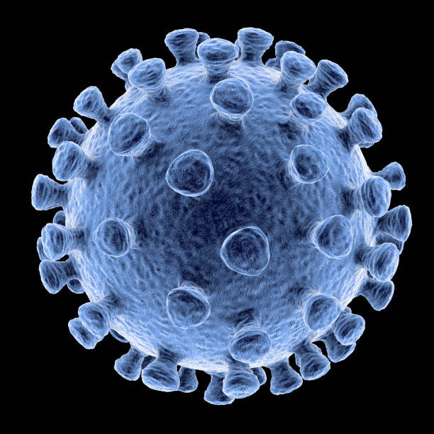
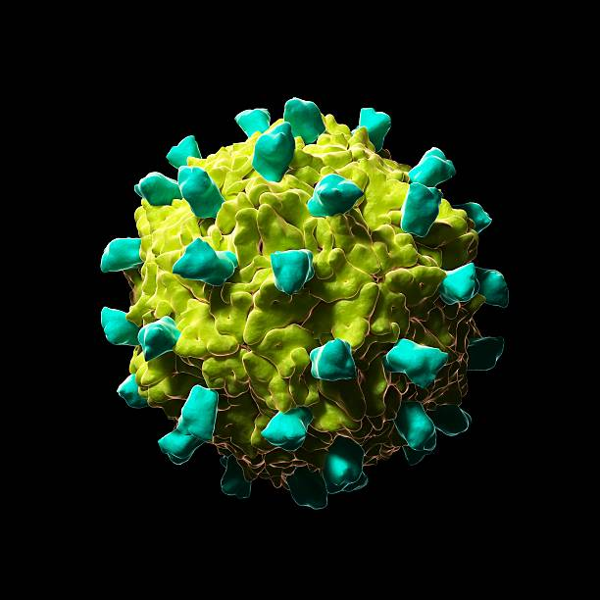
Covid-19 data analysis and visualization using python
Name :- Jaspreet Mashalu
Class:-B.Tech(AI&ML)
NAME- Jaspreet Mashalu
COURSE-B.Tech (AI&ML)

Slide 2

Company Profile
Certification: ISO 9001:2015 Certified
Specializations:
Web Development
Mobile Application Development
Custom Software Development
UI/UX Design
Hosting Services
Digital Marketing
Services:
Advanced IT solutions supporting the entire business
Consulting to system development
Deployment
Quality Assurance
24x7 Support
Headquarters: Jalandhar
Branch Office: Hoshiarpur

Slide 3
INDEX
1.Introduction
2.Problem statements
3.Project Objectives
4.Project Features
5.Project Requirements
6.Data Collection and Preprocessing
7. Results and Visualizations
8.Screenshots
9.Conclusion
10.Future Scope
11.Thank You

Slide 4
Introduction
COVID-19 is a global pandemic that affected millions of people worldwide.
This project analyzes COVID-19 data using Python.
The dataset contains information such as Confirmed Cases, Deaths, Recovered Cases, Active Cases, New Cases, and Country.
Data preprocessing techniques were used to clean and prepare the dataset.
Different charts and graphs were created to visualize the data.
The project helps identify trends, patterns, and comparisons in COVID-19 cases.
This analysis supports better understanding of the pandemic through data visualization.

Slide 5
Problem statements
During the COVID-19 pandemic, managing patient records manually was difficult and time-consuming.
People often faced challenges in getting accurate and up-to-date information about COVID-19 cases and guidelines.
Hospitals and healthcare centers needed a better system to manage patient data and COVID-19 records efficiently.
Manual record-keeping increased the chances of errors, duplicate entries, and delays in accessing information.
There was a need for a centralized system to store, update, and manage COVID-19-related data.
The project aims to provide an easy-to-use platform for managing COVID-19 information accurately and efficiently.
The system helps improve data management, quick access to information, and supports better decision-making.

Slide 6
Project
Objectives
To analyze the COVID-19 dataset using Python.
To clean and preprocess the dataset for accurate analysis.
To visualize COVID-19 data using different charts and graphs.
To compare confirmed, recovered, active, and death cases.
To identify trends and patterns in the spread of COVID-19.
To present data in a simple and easy-to-understand visual format.

Slide 7
Case Tracking: Helps track COVID-19 cases, recoveries, and affected patients.
Data Storage: Maintains COVID-19-related data in a structured and secure database.
Vaccination Information: Provides details about vaccination status, availability, and related updates.
Report Generation: Generates reports based on stored COVID-19 data for analysis
Easy-to-Use Interface: Provides a simple and user-friendly design for better accessibility.
Data Security: Protects user and patient information from unauthorized access. Real-Time Updates: Helps provide the latest information and updates related to COVID-19.
Patient Record Management: Stores and manages patient details, health status, and medical records.
Project Features

Slide 8
Project Requirements
Python - Core Programming Language
Python Libraries :-
Pandas – Data cleaning and analysis
NumPy – Numerical computations
Matplotlib- Data visualization(charts and graphs)
Seaborn- For visualization
Streamlit –Interactive web dashboard
VS Code – Code editor and development environment
Jupyter natebook – Code editor

Slide 9
Data Collection and
Preprocessing
Collected the COVID-19 dataset.
Checked the dataset for missing values.
Removed unnecessary or duplicate data.
Organized the data for analysis.
Prepared the dataset for visualization
Converted the data into the correct format.
Verified the dataset before analysis..

Slide 10
Results and Visualizations
Displayed the data using charts and graphs.
Identified trends and patterns in COVID-19 data.
Generated clear and easy-to-understand visualizations.
Improved data understanding through graphical analysis.
Presented the final analysis results effectively.
Compared confirmed, recovered, active, and death cases.

Slide 11
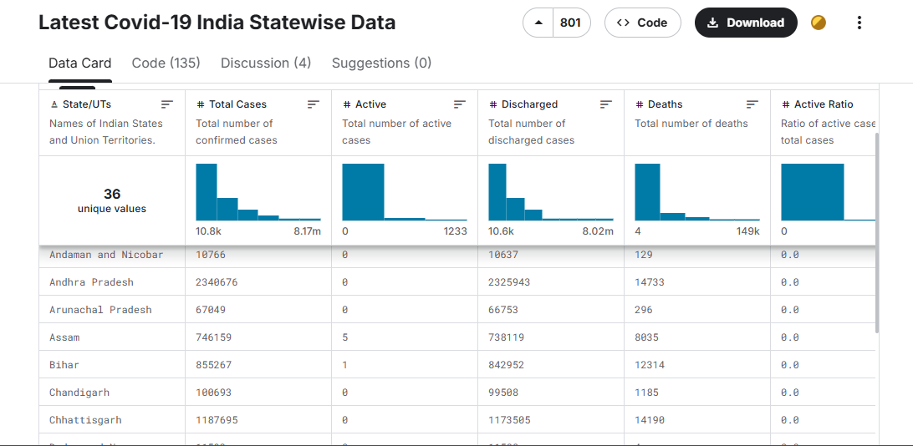
Screenshots

Slide 12
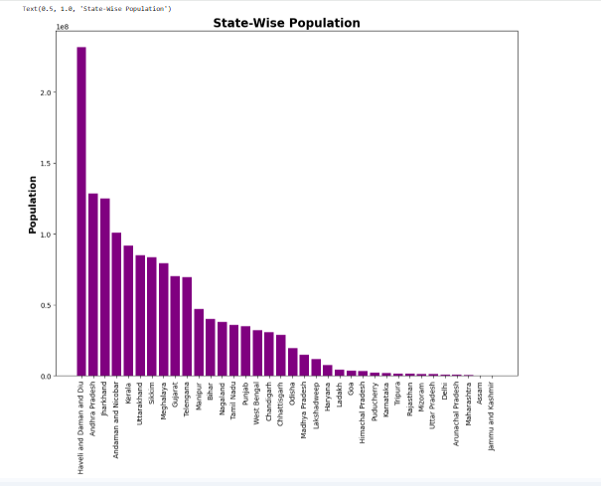

Slide 13
Conclusion
Successfully analyzed the COVID-19 dataset.
Cleaned and processed the data effectively.
Created charts and graphs for better understanding.
Identified important trends and patterns.
Improved data interpretation through visualization.
Achieved the project objectives successfully

Slide 14
Future
Scope
Use real-time COVID-19 data for analysis.
Add interactive dashboards for better visualization.
Include prediction of future case trends.
Analyze data at state and district levels.
Improve the project with advanced machine learning techniques.

Slide 15
Thank
YOU

